Slide 1
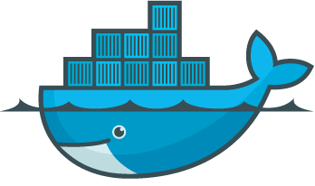
F# with Cassandra on Docker
Notes:
Hello everyone! It’s very nice to be here in Redmond Channel 9 studio and talk to the virtual audience all over the world!

Slide 2
Alena Hall
(Alena Dzenisenka)
Solution Architect, MS in Computer Science
Lots of distributed systems, highly loaded computations, efficient data storages, data science and machine learning
Member of F# Software Foundation Board of Trustees
International speaker and active software engineering community member
Notes:
My name is Lena!
I am a Solutions Architect, specialized on Data, distributed systems, high load, could, data science and all these things.
I am also a member of F# Software Foundation Board Of Trustees.

Slide 3
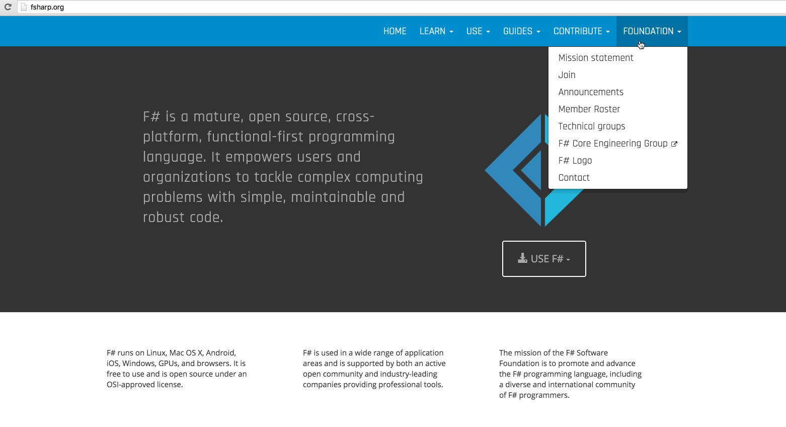
JOIN F# SOFTWARE FOUNDATION!
1
Notes:
And please, join the F# Software Foundation, it brings you only benefits in educational sense and different initiatives you can be a part of, if you are a member!
For example, these was a F# mentorship program announced recently, it allows people who want to learn more about F# to learn something from F# mentors and F# experts.
So, join, everyone is welcome!

Slide 4
CONTENTS
TL;DR: will talk much about distributed systems, make a C* cluster on Docker and run queries from F# solution!
Cassandra internals. Tips & tricks for efficient data models
Creating a data model for today’s demo
Setting up a Cassandra cluster based on Docker
Building a cross-platform F# solution to interact with C* cluster
Notes:
Now I’m gonna jump straight to the topic, because there are a lot of things I want to tell you and just 45 minutes of time.
As an end goal of today’s talk, we will build a cross platform F# solution to interact with Cassandra database on Docker, which we will also build from scratch.
To do that we should do a few things first:
Understand what is Cassandra and why in the world we need it
Talk about the data model for today’s demo
I will show you how to create a Cassandra cluster (which will consist of 3 nodes, for speed of the talk)
And how to create it fast and modular, that’s why we will use Docker
After that we will use F# to interact with what we’ve built!
I won't stop on the F# syntax because people before me have already done a pretty good job, and I have a couple of recorded talks that cover that.
So we will be able to focus on more complicated things, such as, how to work with distributed systems and how to use F# to interact with it.

Slide 5
CASSANDRA
1
Notes:
There we go, Cassandra!
Cassandra is a very powerful distributed database.
To make it more specific, it is a column-family NoSQL database, very good at scaling, very good at being highly available, it’s an AP (available, partition-tolerant) system in terms of CAP theorem tradeoff.
That’s a 10 000 feet view on what Cassandra is.
Now to justification, or, the why.
On the IT business market, a lot of major practical problems today are related to data processing, efficient data storage, data management and so on. Companies of any sort are willing to have their data critical solutions available for users with low latency, being able to scale out and react fast, and of course, to store all the data.
Even though Cassandra is written in Java, it can be used with our favorite programming language - F#. It has an official .NET driver which we’re gonna use later in the demo, it also has some open source connectors, which you can try out with F#. But here I am just gonna stick to official driver.
F# has pretty amazing features and infrastructure, so why not to use it for our projects with Cassandra, if we can!

Slide 6
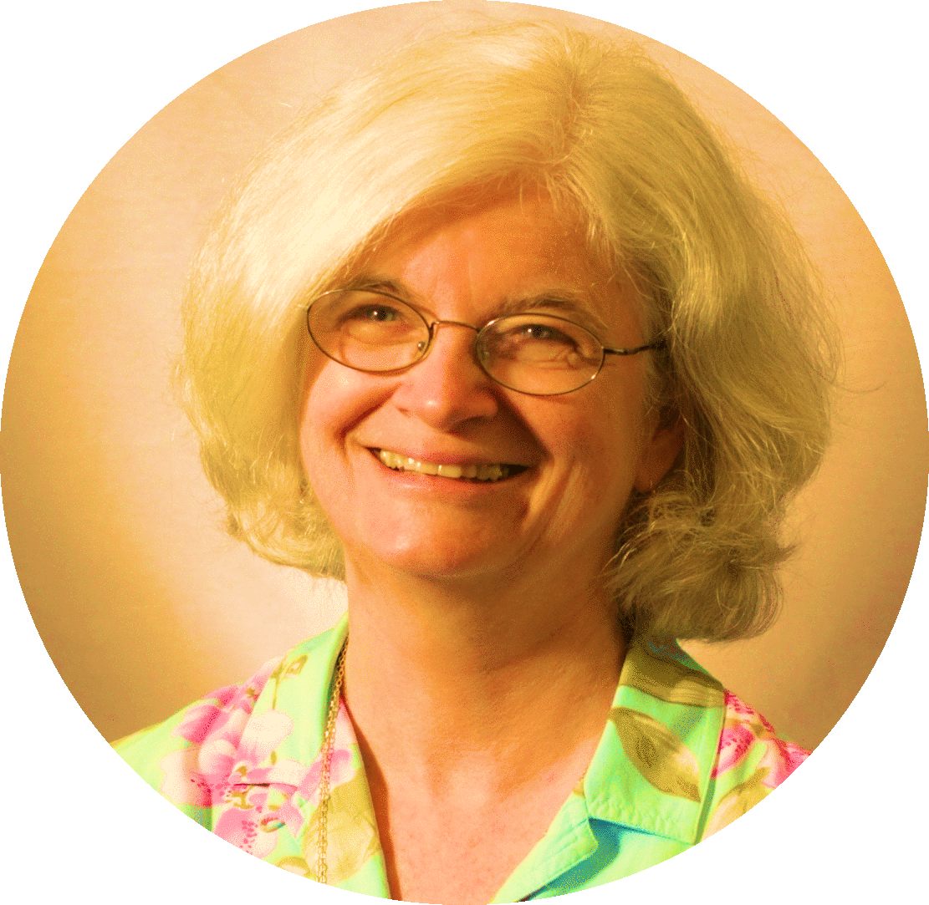
“A distributed system is one in which the failure of a computer you didn't even know existed can render your own computer unusable”
Leslie Lamport
Nancy Lynch
Michael Fischer
Notes:
Distributed systems are hard, and Cassandra is a distributed data storage.
This is a very true quote from Leslie Lamport, the guy who created Lamport clocks, Vector clocks, Paxos and other major algorithms in the world of distributed systems.

Slide 7
Cassandra Internals
Distributed database, has a ring topology, uses consistent hashing
Highly available system with tunable consistency and hinted hand off
Data is grouped by the partition key and stored together physically
Stores data in SSTable on disk and RAM and tracks operations in the commit log
Data can be ordered by a clustering key
Supports equality, inequality, aggregation queries and custom functions
Hash ranges can be mapped to Simple Nodes or to Vnodes
Nodes can be grouped in racks and data centers
Notes:
That’s why I MUST tell you about the important aspects of internal Cassandra architecture.
I think you’d love it, because it has a LOT of things in common with Functional Programming approaches.
Cassandra nodes are formed together in a ring topology cluster. When new data entry wants to come it – the cluster already knows on what node it should be placed, because each node in the cluster is responsible for some limited hash range from the overall hash circle ring. Based on the partition key of our data the coordinator will send the data exactly to the node that’s responsible for it, and most likely to some other nodes, if the replication factor is more than just 1.
Cassandra is also a highly available system, it’s completely masterless, all nodes are acting in a peer-to-peer fashion, any of them can accept requests and act as a coordinator. For example, if there is a change request for some data entry, that resides on the node #3, and the request appeared to arrive to the node #7, if after that #3 unexpectedly goes down, #7 would be responsible for temporarily storing the updated entry in it’s hints table and propagate changes to the node #3 after it restores after the failure.
Even though Cassandra is an AP system, it doesn’t mean that all requests end up inconsistent. We can tune the consistency per query. The general rule is, your query is consistent when R + W > N (read cons + white cons > replication factor)
Important thing is, we can get extremely fast queries when we query by the partition key, because all entries with the same partition are stored together on the physical level.
Speaking of, Cassandra writes are first written to the immutable append-only commit log, and then to a per-ColumnFamily structure Memtable, which, as you might have guessed, is in RAM. When the Memtable is full – it is flushed to the disk and stored in a SSTable file. Periodically, SSTable files on disk are compacted to a single, bigger SSTable file.
You can also group the nodes into several racks and data centers to add more fault tolerance or geographical optimizations.\

Slide 8
Efficient data modeling
Know your data access patterns
Build tables optimized for queries
Yes, denormalize
Correct partition key is half the battle
Conceptual Data Model
Logical Data Model
Physical Data Model
Notes:
If in relational databases the goal of the primary key is to provide uniqueness, in Cassandra the primary key serves two purposes: uniqueness and satisfaction of the table's queries.
Therefore, the data modeling process differs from the one we are using in the relational world.
As a first rule of any good architecture, we create the conceptual data model first, it is independent of any technology.
Then, working with RDBMS we create tables for entities and for many-to-many relationships, following the rules of normalization. We save some space by normalizing our data model, but to query data we perform a lot of joins, which are very expensive resulting in the fact that latency sucks. The problem of RDBMS is also the known issues and complexity of scalability when your data becomes really big. Relational systems trade-off low latency and the ease of scalability for saving the disk space and providing consistent transactions.
With Cassandra you get a very low latency and decent scalability, but it will utilize more disk space because of it's data storage approach.
As I have mentioned, it stores data with the same partition key on disk together, physically. All queries are fast when you query by partition key.
When building data models think about what you want to DO with your data, and then create tables optimized for that.
There is no right and wrong, you just choose what is more critical for you - fast response and scalability or disk space and transactions.

Slide 9
Let’s take the sample data model
CREATE TABLE coffee_shops_by_street (
street text,
coffee_shop text,
hours text,
capacity int,
house_number int,
open_on_weekend boolean,
PRIMARY KEY (street, coffee_shop) )
WITH CLUSTERING ORDER BY (coffee_shop ASC)

Slide 10
AND TABLES TO COMPARE DATA
 | A | B | C
Yellow | 10 | 20 | 7
Blue | 30 | 15 | 10
Orange | 5 | 24 | 16
Notes:
Data is organized together by the partitions, so all coffee shops on the Mississippi street are stored together
Deleted entries are not deleted immediately, but are marked for deletion. They are ignored by queries, and will be deleted eventually.
Within the partition, data is ordered by the clustering column, which in our case is a coffee shop name.
Partition stores rows of data as key value pairs for each column
As you might have noticed, each row stores the timestamp.
It is an awesome technology and we can use it with F#!!

Slide 11
1
Notes:
We gonna also use docker, because it’s a great container management tool and I will just show you how easy it is to work with.

Slide 12
CLUSTER: STEP 1
`
Let’s create Cassandra Nodes using Docker!

Slide 13
Creating Docker containers
For the first node:
$ docker run --name name-of-your-node cassandra
For the 2nd and 3rd nodes:
$ docker run --name name-of-your-new-node
... --link name-of-your-node:cassandra -d cassandra
How to go to the bash terminal of the docker container? Simple.
$ docker exec -it name-of-your-node bash
To see the status of the cluster:
nodetool status

Slide 14
CLUSTER: STEP 2
`
Let’s configure the C* nodes…

Slide 15
Configuring Cassandra nodes … or … /etc/cassandra/cassandra.yaml
cluster_name
listen_address
rpc_address
seeds

Slide 16
CLUSTER: STEP 3
`
Let’s open the necessary ports…

Slide 17
Ports, don’t forget to open!
WANT BIG IMPACT?
Use big image.

Slide 18
PUTTING ALL TOGETHER
`

Slide 19
Cross platform F# solution to interact with Cassandra cluster!

Slide 20
What’s next?
ProjectScaffold |> I
Paket !
Xamarin Studio
Notes:
It doesn't leave you dependent on other dependency build tools like NuGet
You can use github, nuget or other sources

Slide 21
ProjectScaffold
Clone it:
$ git clone https://github.com/fsprojects/ProjectScaffold.git
Build it:

Slide 22
Paket!
Add dependency for Cassandra library to paket.dependencies:
Update dependencies:
$ paket install

Slide 23
Place your screenshot here
DEMO

Slide 25
INTERNAL STATE OF DATA
`

Slide 26
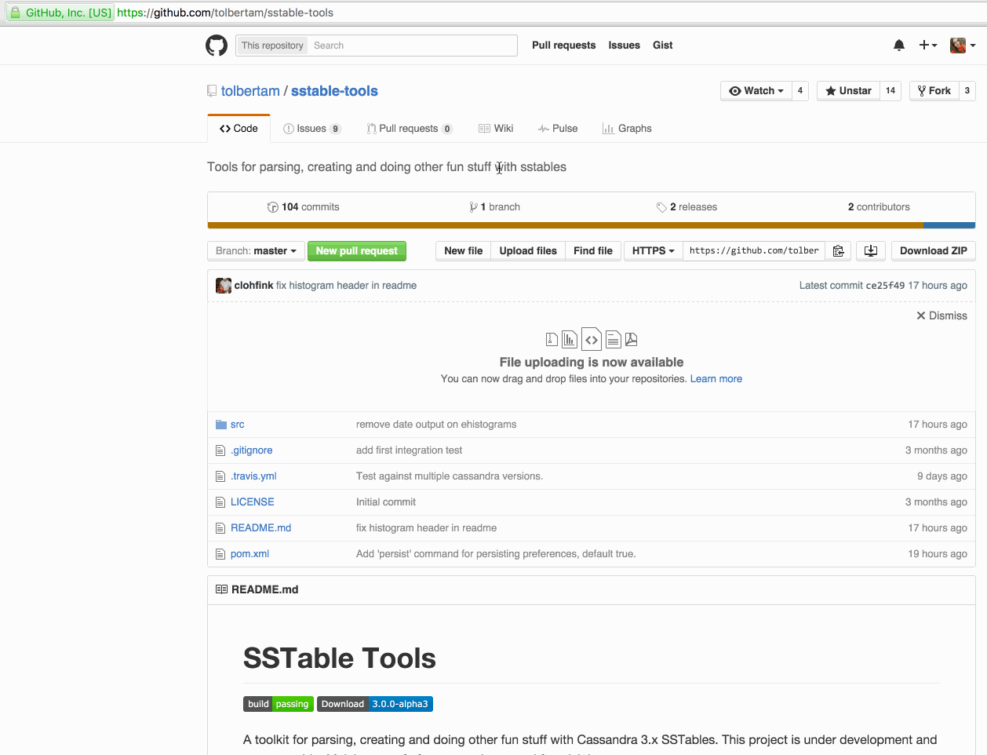

Slide 27
REACH OUT!
`
@lenadroid
lenokhall@gmail.com

Slide 28
Thank you!

